Slide 1
Capstone Project
Hotel Booking Analysis | EDA Team Member’s: Rohit Raj Swen Fereira Nikhil Machave Sameer Talashilkar

Slide 2
Points For Discussion
Agenda
Data Summary
Overview of Hotel Type
Analysis on Hotels & Bookings
Analysis on Customer Preference
Overview of Market Segments
Correlation between Features ( Heat Map )
Conclusion

Slide 3
Agenda
To perform EDA on hotel bookings data set from 2015-2017.
We’ll be doing analysis of given data set in following ways :
• Overview of the type of hotel
• Analysis on Hotels & Bookings
• Analysis on Customer Preference
• Overview of Market Segments
• Correlation Between Features ( Heat Map)
By doing this we’ll try to find out key factors driving the hotel bookings trends.

Slide 4
Data Summary
Given data set has different columns of variables crucial for hotel bookings.
Some of them are:
hotel: Type of Hotels
is_cancelled : cancelled or not | Values[0,1], where 0 indicates not cancelled.
lead_time : The time between reservation and actual arrival.
stays_in_weekend_nights: The number of weekend nights stay per reservation
stays_in_weekday_nights: The number of weekday nights stay per reservation.
meal: Meal preferences per reservation. (BB,FB,HB,SC,Undefined)
Country: The origin country of guest.

Slide 5
Data Summary
market_segment: A group of people who share one or more similar characteristics
- TA: Travel agents
- TO: Tour operators
distribution_channel: The medium through booking was made.[Direct,Corporate,TA/TO,undefined,GDS.]
Is_repeated_guest: Shows if the guest is who has arrived earlier or not.Values[0,1]-->0 indicates no and 1 indicated yes person is repeated guest.
days_in_waiting_list: Number of days between actual booking and transact.
customer_type: Type of customers( Transient, group, etc.)

Slide 6
Overview of the Hotel Type
Let's try to find out the solutions for the below question.
What is the percentage of booking done in different hotels?
How many total bookings done in different Years?
How many total bookings done in different months?
Total Number of Booking Cancelled in different months?
Total Number of Non-Cancelled Bookings in different months?

Slide 7
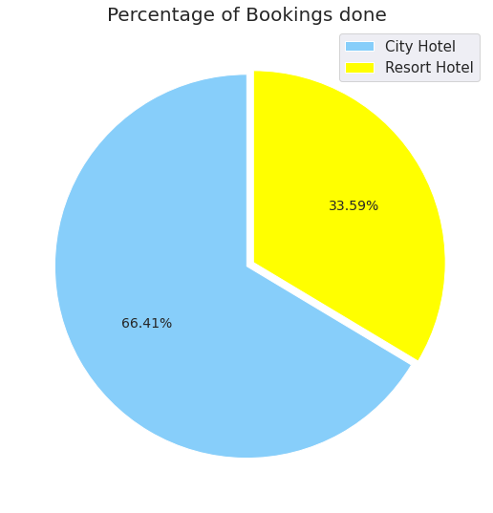
What is the percentage of booking done in different hotels?
Observations :
From the above Pie-Chart, we can conclude that 66.41 % of booking done in City Hotel and 33.59 % of booking done in Resort Hotel.

Slide 8
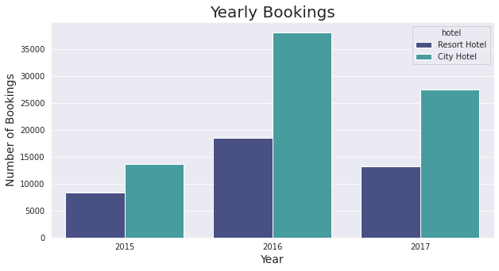
How many total bookings done in different Years?
Observtions : We can see that, In year 2016 most bookings have been made in City Hotel and Resort Hotel.

Slide 9
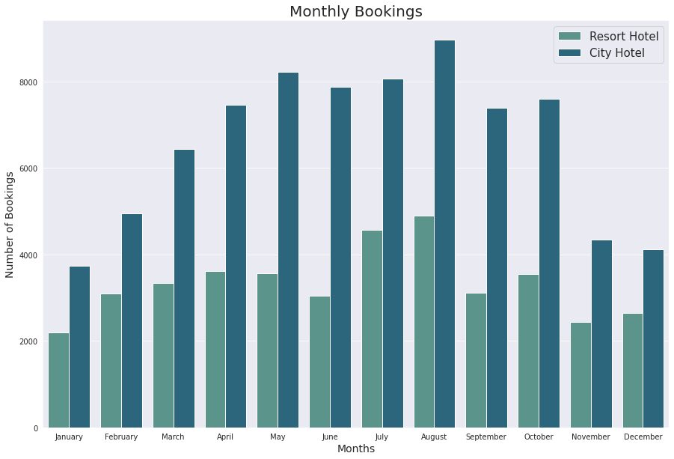
How many total bookings done in different months?
Obervations: Most of the bookings done in the Month of August in Resort Hotel and City Hotel.

Slide 10
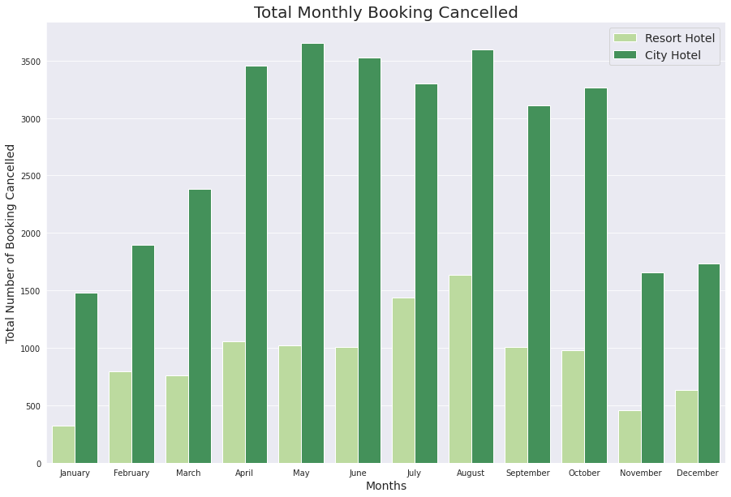
Total Number of Booking Cancelled in different months?
Observations : In May, most of the bookings are cancelled in City Hotel and In August most of the cancellation done in Resort Hotel.

Slide 11
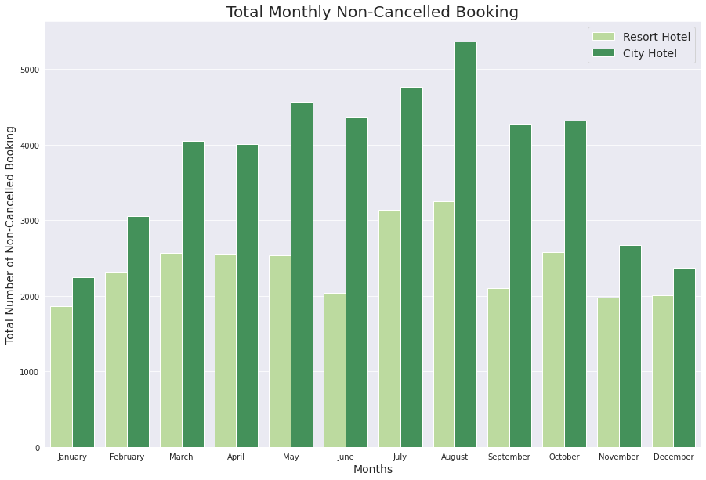
Total Number of Non-Cancelled Bookings in different months?
Observations: Maximum number of Booking done in August in City Hotel and Resort Hotel that are Not-Cancelled.

Slide 12
Analysis on Hotels & Bookings
Let's try to find out the solutions for the below question.
How many days customers prefer to stay in week night?
How many days customers prefer to stay in weekend night?
what is the most preferred meal type by customers?
How many customers are making special Request?
Which one is most preferred room type?

Slide 13
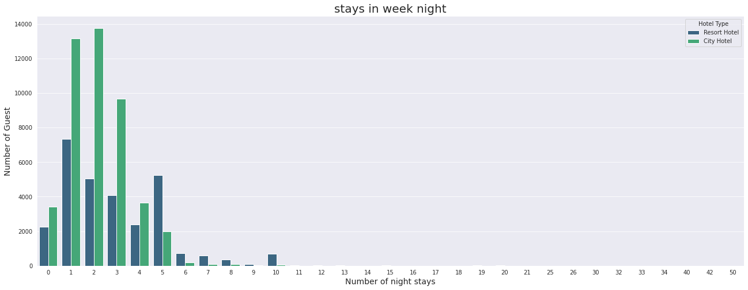
How many days customers prefer to stay in week night?
Observations : Most of the customers preferred to stay for 2 days in City Hotel and 1 day in Resort Hotel.

Slide 14
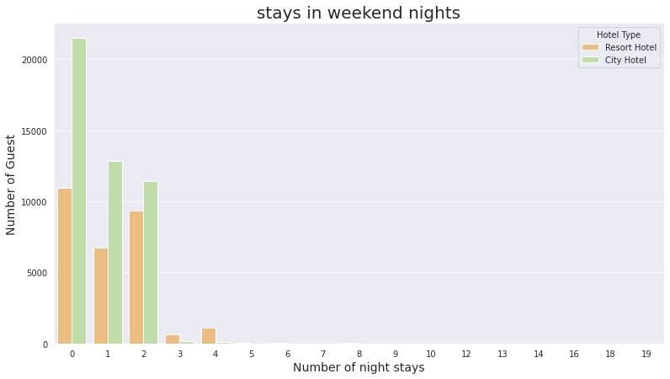
How many days customers prefer to stay in weekend night?
Observations : Most customer stays for 0 nights in Resort and City hotels.

Slide 15
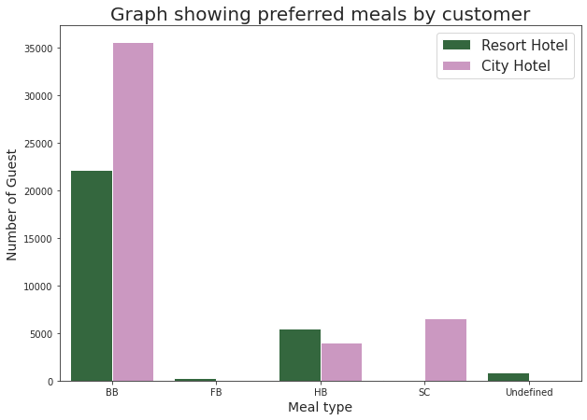
What is the most preferred meal type by customers?
Observations : Most preferred meal by customer is BB for Resort and City Hotel

Slide 16
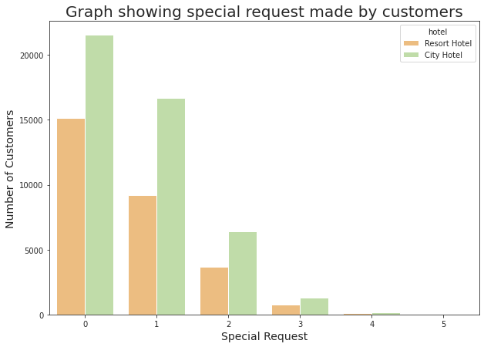
How many customers are making special Request?
Observations : Most of the customers do not make any special request.

Slide 17
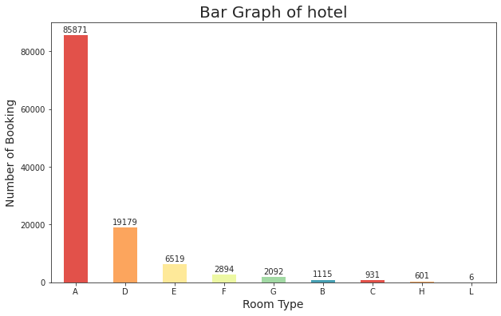
Which one is most preferred room type?
Observations : Most Preferred room type by customer is Room A..

Slide 18
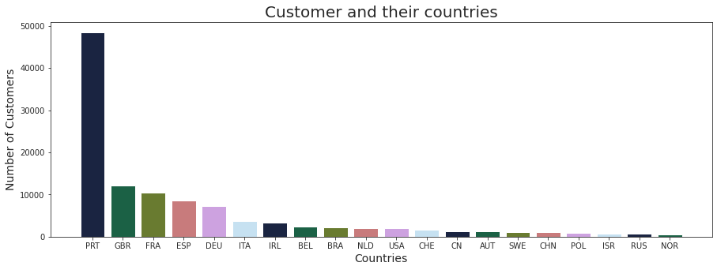
Top 20 Countries from where most number of customers are booking
Observations : Most of the customers are from PRT.

Slide 19
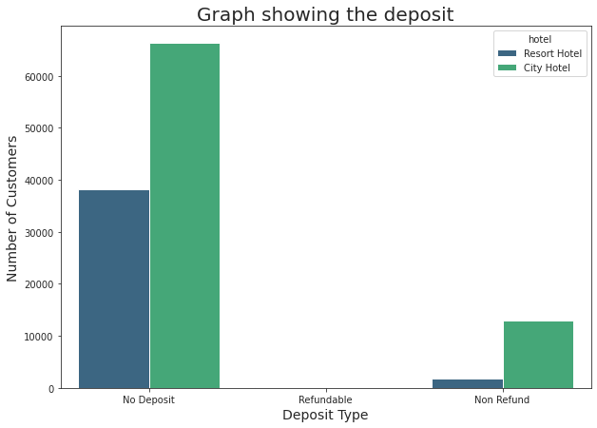
Deposit Type.
Observations : Most of the customers prefer No Deposit for booking.

Slide 20
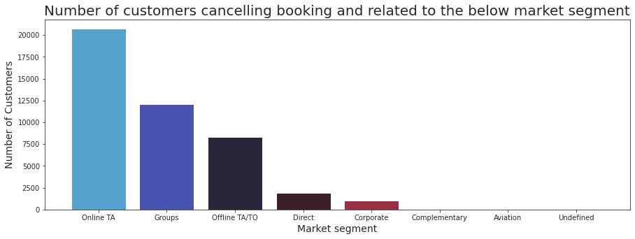
Plot of cancelling booking from given market segment.
Observations : Most of the customers from Online TA cancel their booking.

Slide 21
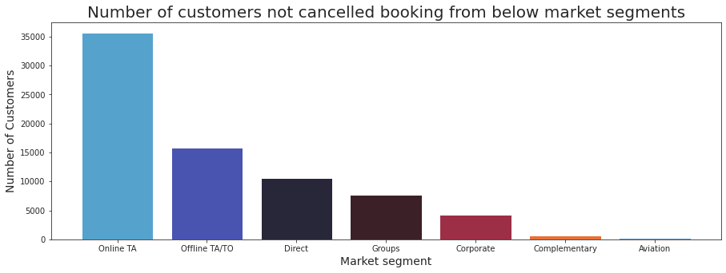
Plot of not cancelling booking from given market segment.
Observations : Most of the customer from Online TA are not Cancelling their bookings.

Slide 22
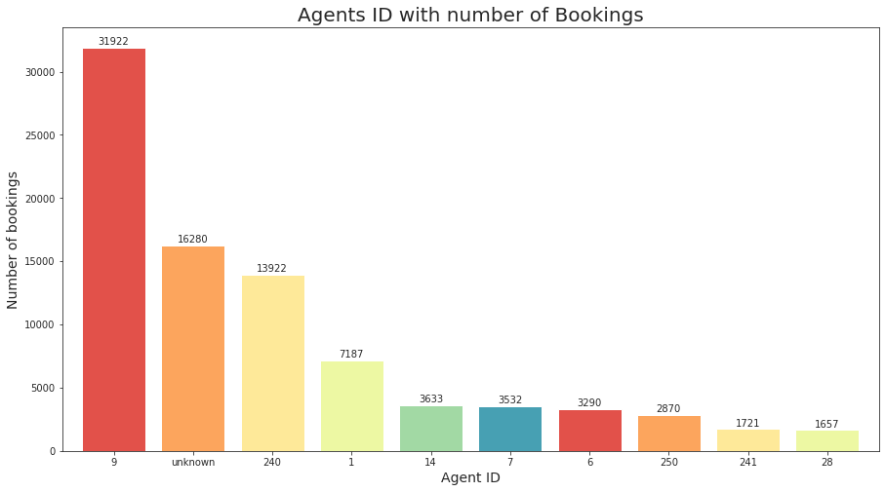
Which Agent(id) is booking the most number of hotels
Observations : Agent with ID 9, books most number of hotels.

Slide 23
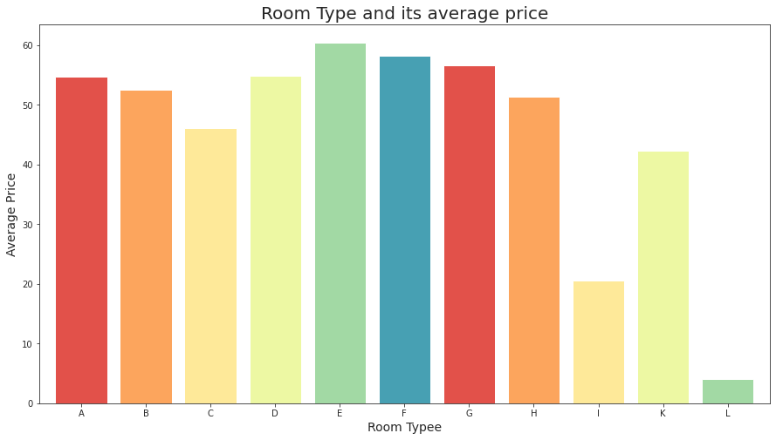
Room type and average price
Observations : The average price of Room E is the maximum and the average price of Room L is minimum.

Slide 24
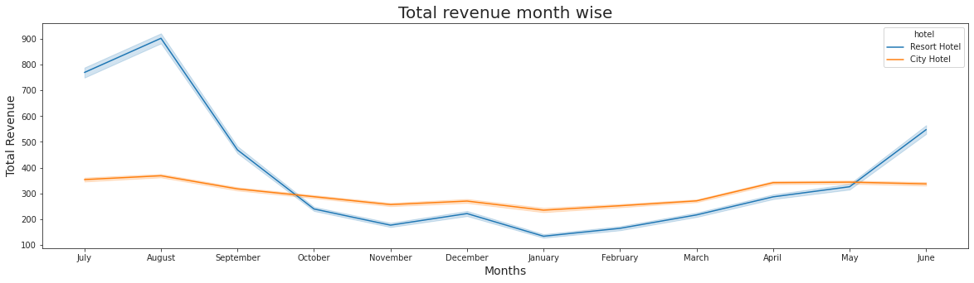
Revenue per month per hotel
Observations : Revenue of Resort Hotel are maximum in the month of August and least in the month of January and there is no high fluctuation in the price of city Hotels throughout the Year.

Slide 25
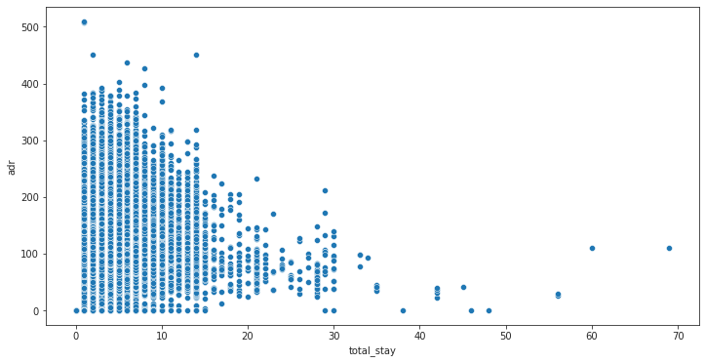
Plotting Scatter plot to find the optimal length of stay
Observations : The longer the stay length, the best price customer will get.

Slide 26
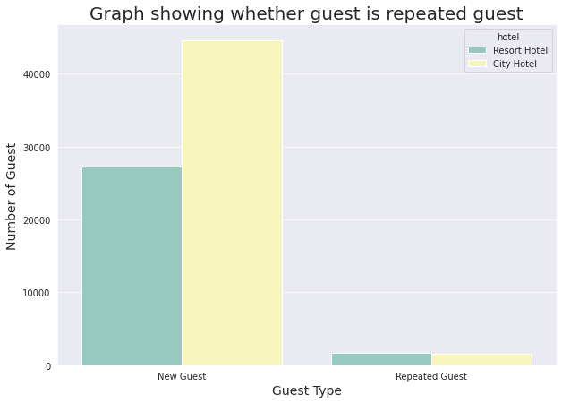
Number of repeated guests
Observations : We have more number of New Guest in both type of hotels.

Slide 27
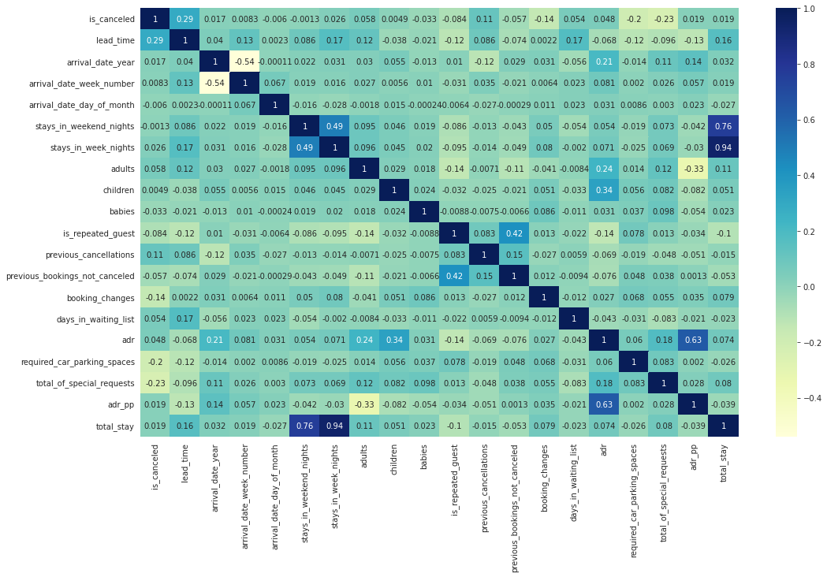
Correlation between features
Observations : Total stay is highly correlated with stays_in_weekend_nights and stays_in_week_nights.

